Slide 1
Welcome
To our Presentation
ON
Stem cells……

Slide 2
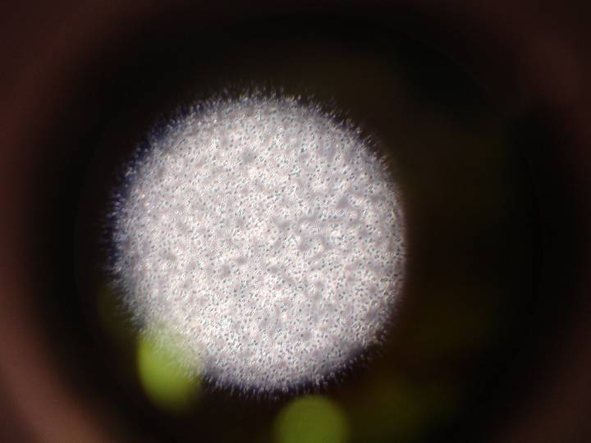
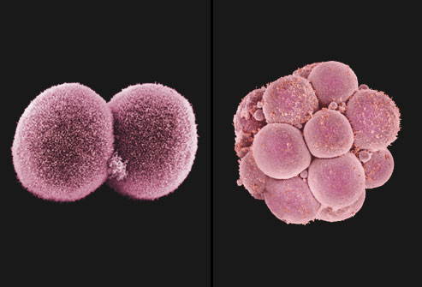
Stem Cells
Notes:
2

Slide 3
Stem Cell History
1998 - Researchers first extract stem cells from human embryos
1999 - First Successful human transplant of insulin-making cells from cadavers
2001 - President Bush restricts federal funding for embryonic stem-cell research
2002 - Juvenile Diabetes Research Foundation International creates $20 million fund-raising effort to support stem-cell research
2002 - California ok stem cell research
2004 - Harvard researchers grow stem cells from embryos using private funding
2004 - Ballot measure for $3 Billion bond for stem cells

Slide 4
Stem Cell – Definition
Stem Cell – Definition
A cell that has the ability to continuously divide and differentiate (develop) into various other kind(s) of cells/tissues

Slide 5
Stem Cell Characteristics
‘Blank cells’ (unspecialized)
Capable of dividing and renewing themselves for long periods of time (proliferation and renewal)
Have the potential to give rise to specialized cell types (differentiation)

Slide 6
Kinds of Stem Cells
Embryonic stem cells
five to six-day-old embryo
Tabula rasa
Embryonic germ cells
derived from the part of a human embryo or fetus that will ultimately produce eggs or sperm (gametes).
Adult stem cells
undifferentiated cells found among specialized or differentiated cells in a tissue or organ after birth
appear to have a more restricted ability to produce different cell types and to self-renew.

Slide 7
Kinds of Stem Cells
Embryonic stem cells
five to six-day-old embryo
Tabula rasa
Embryonic germ cells
derived from the part of a human embryo or fetus that will ultimately produce eggs or sperm (gametes).
Adult stem cells
undifferentiated cells found among specialized or differentiated cells in a tissue or organ after birth
appear to have a more restricted ability to produce different cell types and to self-renew.

Slide 8
Pluripotent Stem Cells – more potential to become any type of cell

Slide 9
Multipotent stem cells
Multipotent stem cells – limited in what the cells can become

Slide 10
Embryonic Stem Cells

Slide 11
Adult Stem Cells
An undifferentiated cells found among specialized or differentiated cells in a tissue or organ after birth
Skin
Fat Cells
Bone marrow
Brain
Many other organs & tissues

Slide 12
Induced Pluripotent Stem Cells

Slide 13
Bone Marrow
Found in spongy bone where blood cells form
Used to replace damaged or destroyed bone marrow with healthy bone marrow stem cells.
treat patients diagnosed with leukemia, aplastic anemia, and lymphomas
Need a greater histological immunocompatibility

Slide 14
Umbilical cord stem cells
Also Known as Wharton’s Jelly
Adult stem cells of infant origin
Less invasive than bone marrow
Greater compatibility
Less expensive

Slide 15
Umbilical cord stem cells
Three important functions:
Plasticity: Potential to change into other cell types like nerve cells
Homing: To travel to the site of tissue damage
Engraftment: To unite with other tissues

Slide 16
Stem Cell Applications
Tissue repair
- nerve, heart, muscle, organ, skin
Cancers
Autoimmune diseases
- diabetes, rheumatoid arthritis, MS

Slide 17
Tissue Repair
Regenerate spinal cord, heart tissue or any other major tissue in the body.

Slide 18
Heart Disease
Adult bone marrow stem cells injected into the hearts are believed to improve cardiac function in victims of heart failure or heart attack

Slide 20
Stem cells in the adult brain:

Slide 21
Problems with Adult Stem Cells

Slide 22
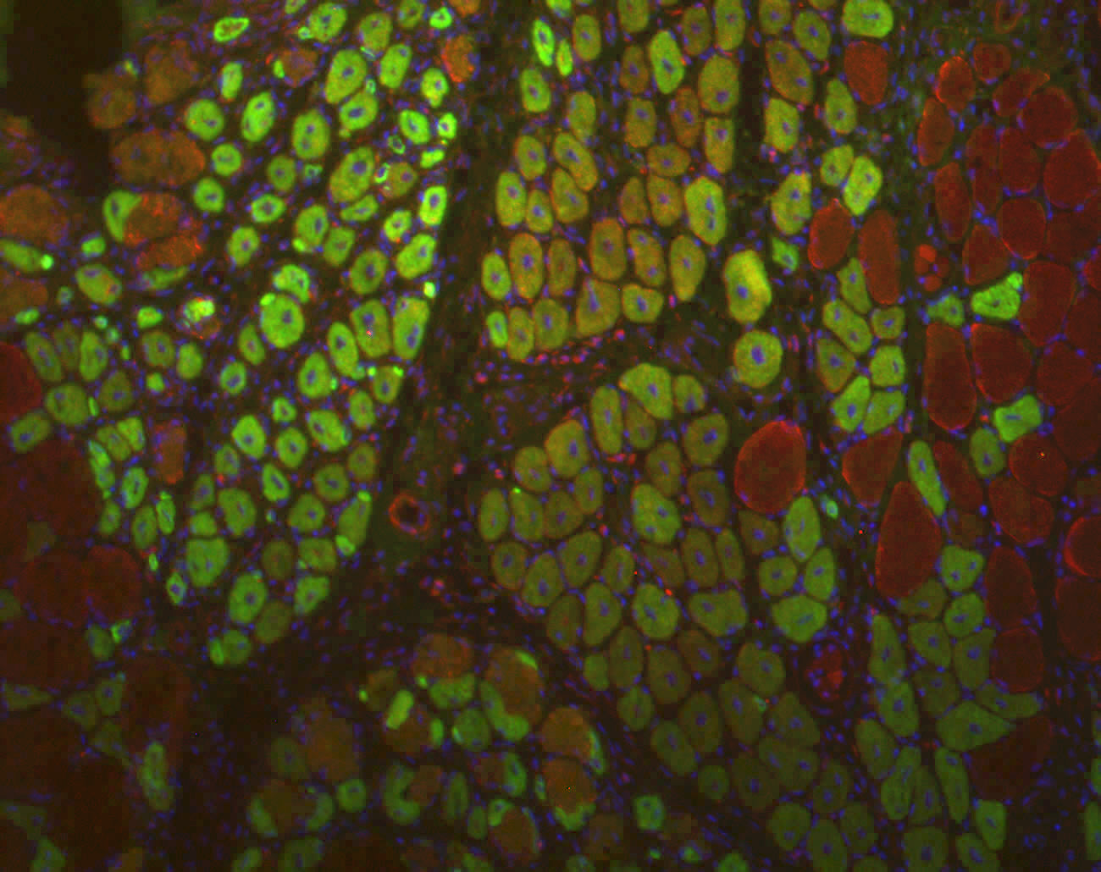
Stem cells in mature skeletal muscle: Is there power still in our stem cells?

Slide 23
What is stem cell research?
Understand more about development, aging, disease
Experimental model systems
Prevent or treat diseases and injuries
Cell-based therapies
Pharmaceutical development
Includes testing and drug delivery

Slide 24
Why is Stem Cell Research So Important to All of Us?
Stem cells can replace diseased or damaged cells
Stem cells allow us to study development and genetics
Stem cells can be used to test different substances (drugs and chemicals)

Slide 25
Thank you for watching
BY:- MADHULA & MADHURI 2nd B.Sc(B.G.B)

